Slide 1
5
Accounting for Merchandising Operations
Learning Objectives
1
Describe merchandising operations and inventory systems.
2
Record purchases under a perpetual inventory system.
3
Record sales under a perpetual inventory system.
4
Apply the steps in the accounting cycle to a merchandising company.
5
Compare a multiple-step with a single-step income statement.

Slide 2



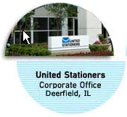
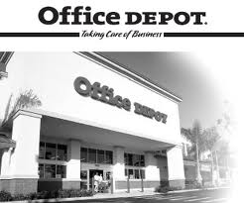


LEARNING
OBJECTIVE
Describe merchandising operations and inventory systems.
1
Merchandising Companies
Buy and Sell Goods
Retailer
Wholesaler
Consumer
The primary source of revenues is referred to as sales revenue or sales.
LO 1

Slide 3
Merchandising Operations
Income Measurement
Sales
Revenue
Not used in a Service business.
Less
Illustration 5-1
Income measurement process for a merchandising company
Cost of
Goods Sold
Equals
Gross
Profit
Less
Operating
Expenses
Net
Income
(Loss)
Cost of goods sold is the total cost of merchandise sold during the period.
Equals
LO 1

Slide 4
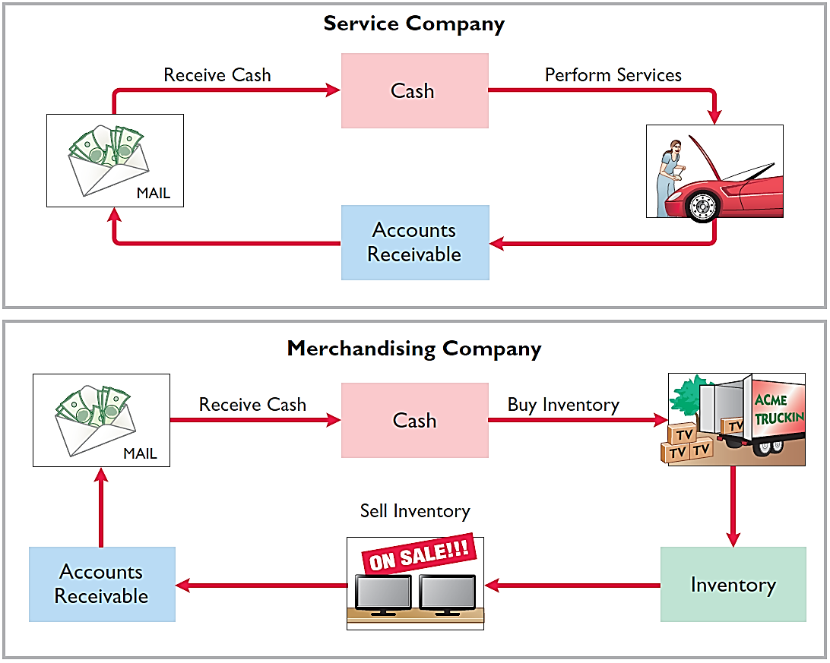
Operating Cycles
The operating cycle of a merchandising company ordinarily is longer than that of a service company.
Illustration 5-2
Illustration 5-3
LO 1

Slide 5
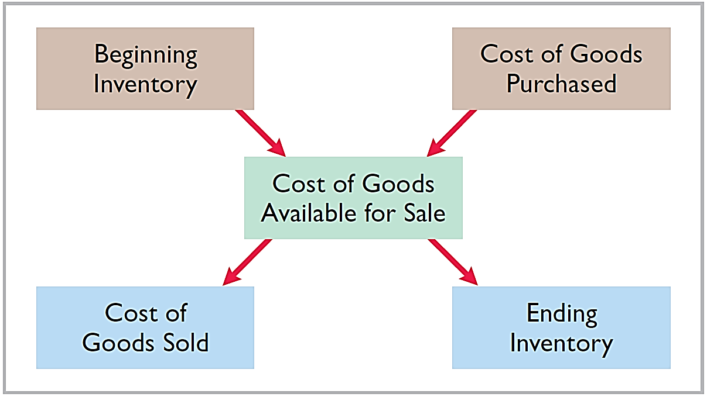
Flow of Costs
Illustration 5-4
Companies use either a perpetual inventory system or a periodic inventory system to account for inventory.
LO 1

Slide 6
Flow of Costs
PERPETUAL SYSTEM
Maintain detailed records of the cost of each inventory purchase and sale.
Records continuously show inventory that should be on hand for every item.
Company determines cost of goods sold each time a sale occurs.
LO 1

Slide 7
Flow of Costs
PERIODIC SYSTEM
Do not keep detailed records of the goods on hand.
Cost of goods sold determined by count at the end of the accounting period.
Calculation of Cost of Goods Sold:
Beginning inventory $ 100,000
Add: Purchases, net 800,000
Goods available for sale 900,000
Less: Ending inventory 125,000
Cost of goods sold $ 775,000
LO 1

Slide 8
Flow of Costs
ADVANTAGES OF THE PERPETUAL SYSTEM
Traditionally used for merchandise with high unit values.
Shows the quantity and cost of the inventory that should be on hand at any time.
Provides better control over inventories than a periodic system.
LO 1

Slide 9

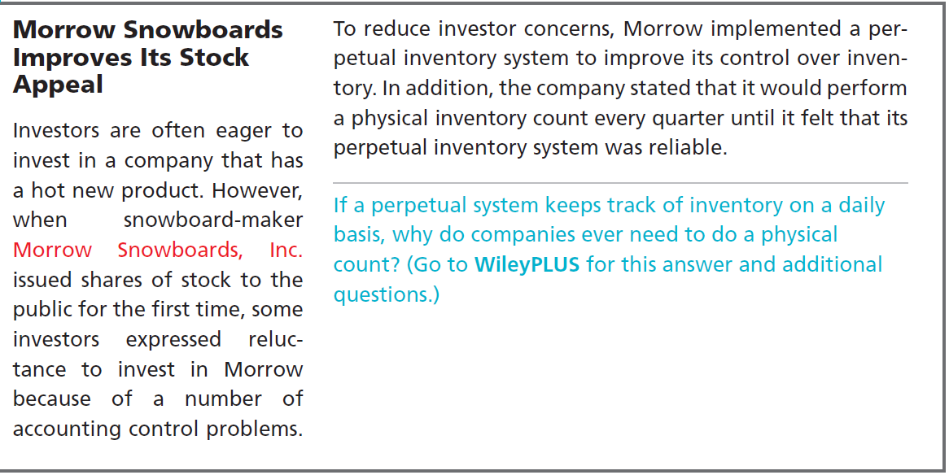
LO 1

Slide 10
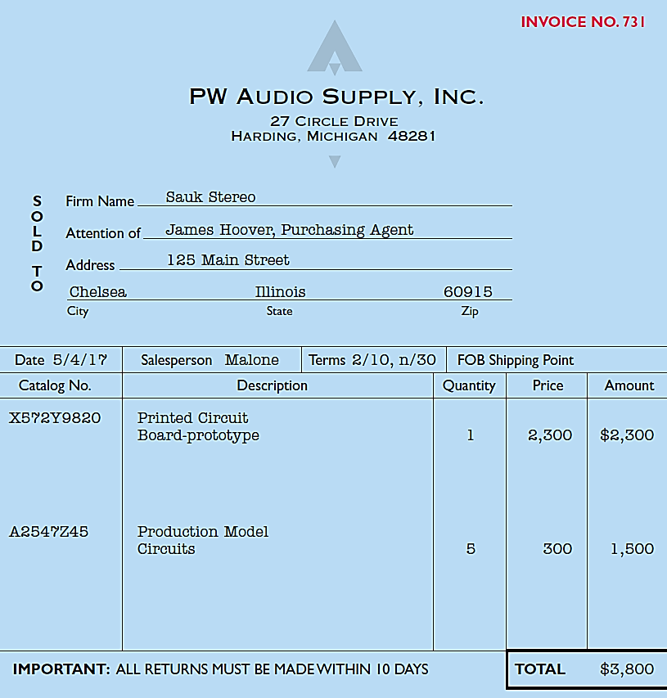
LEARNING
OBJECTIVE
Record purchases under a perpetual inventory system.
2
Made using cash or credit (on account).
Normally record when goods are received from the seller.
Purchase invoice should support each credit purchase.
Illustration 5-6
Sales invoice used as purchase
invoice by Sauk Stereo
LO 2

Slide 11
Recording Purchases of Merchandise
Illustration: Sauk Stereo (the buyer) uses as a purchase invoice the sales invoice prepared by PW Audio Supply, Inc. (the seller). Prepare the journal entry for Sauk Stereo for the invoice from PW Audio Supply.
Illustration 5-6
May 4
Inventory 3,800
Accounts Payable 3,800
LO 2

Slide 12
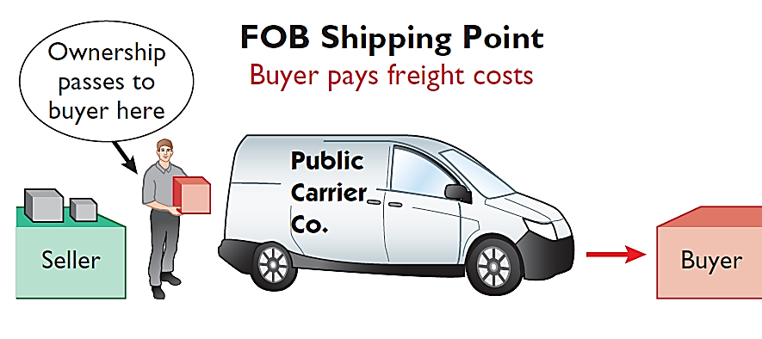
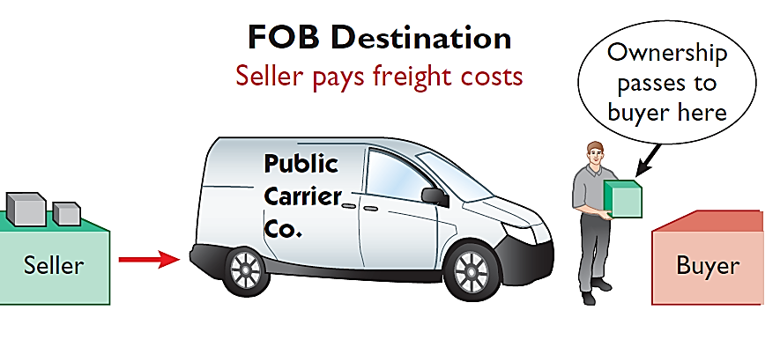
Freight Costs
Ownership of the goods passes to the buyer when the public carrier accepts the goods from the seller.
Ownership of the goods remains with the seller until the goods reach the buyer.
Illustration 5-7 Shipping terms
Freight costs incurred by the seller are an operating expense.
LO 2

Slide 13
Freight Costs
Illustration: Assume upon delivery of the goods on May 6, Sauk Stereo pays Public Freight Company $150 for freight charges, the entry on Sauk Stereo’s books is:
May 6
Inventory 150
Cash 150
Assume the freight terms on the invoice in Illustration 5-6 had required PW Audio Supply to pay the freight charges, the entry by PW Audio Supply would have been:
May 4
Freight-Out 150
Cash 150
LO 2

Slide 14
Purchase Returns and Allowances
Purchaser may be dissatisfied because goods are damaged or defective, of inferior quality, or do not meet specifications.
Purchase Return
Purchase Allowance
Return goods for credit if the sale was made on credit, or for a cash refund if the purchase was for cash.
May choose to keep the merchandise if the seller will grant a reduction of the purchase price.
LO 2

Slide 15
Purchase Returns and Allowances
Illustration: Assume Sauk Stereo returned goods costing $300 to PW Audio Supply on May 8.
May 8
Accounts Payable 300
Inventory 300
LO 2

Slide 16
Purchase Returns and Allowances
Question
In a perpetual inventory system, a return of defective merchandise by a purchaser is recorded by crediting:
Purchases
Purchase Returns
Purchase Allowance
Inventory
LO 2

Slide 17
Purchase Discounts
Credit terms may permit buyer to claim a cash discount for prompt payment.
Advantages:
Purchaser saves money.
Seller shortens the operating cycle by converting the accounts receivable into cash earlier.
Example: Credit terms may read 2/10, n/30.
LO 2

Slide 18
Purchase Discounts
2/10, n/30
1/10 EOM
n/10 EOM
2% discount if paid within 10 days, otherwise net amount due within 30 days.
1% discount if paid within first 10 days of next month.
Net amount due within the first 10 days of the next month.
LO 2

Slide 19
Purchase Discounts
Illustration: Assume Sauk Stereo pays the balance due of $3,500 (gross invoice price of $3,800 less purchase returns and allowances of $300) on May 14, the last day of the discount period. Prepare the journal entry Sauk Stereo makes on May 14 to record the payment.
May 14
Accounts Payable 3,500
Inventory 70
Cash 3,430
(Discount = $3,500 x 2% = $70)
LO 2

Slide 20
Purchase Discounts
Illustration: If Sauk Stereo failed to take the discount, and instead made full payment of $3,500 on June 3, the journal entry would be:
June 3
Accounts Payable 3,500
Cash 3,500
LO 2

Slide 21
Purchase Discounts
Should discounts be taken when offered?
Example: 2% for 20 days = Annual rate of 36.5%
$3,500 x 36.5% x 20 ÷ 365 = $70
LO 2

Slide 22
Summary of Purchasing Transactions
4th - Purchase
3,800
300
8th - Return
6th – Freight-in
150
70
14th - Discount
Balance
3,580
LO 2

Slide 23

DO IT!
2
Purchase Transactions
On September 5, De La Hoya Company buys merchandise on account from Junot Diaz Company. The selling price of the goods is $1,500, and the cost to Diaz Company was $800. On September 8, De La Hoya returns defective goods with a selling price of $200. Record the transactions on the books of De La Hoya Company.
Sept. 5
Inventory 1,500
Accounts Payable 1,500
Accounts Payable 200
Inventory 200
Sept. 8
LO 2

Slide 24
LEARNING
OBJECTIVE
Record sales under a perpetual inventory system.
3
Made using cash or credit (on account).
Illustration 5-6
Sales revenue, like service revenue, is recorded when the performance obligation is satisfied.
Performance obligation is satisfied when the goods are transferred from the seller to the buyer.
Sales invoice should support each credit sale.
LO 3

Slide 25
Recording Sales of Merchandise
Journal Entries to Record a Sale
#1
Cash or Accounts receivable XXX
Selling Price
Sales revenue XXX
#2
Cost of goods sold XXX
Cost
Inventory XXX
LO 3

Slide 26
Recording Sales of Merchandise
Illustration: PW Audio Supply records the sale of $3,800 on May 4 to Sauk Stereo on account (Illustration 5-6) as follows (assume the merchandise cost PW Audio Supply $2,400).
May 4
Accounts Receivable 3,800
Sales Revenue 3,800
4
Cost of Goods Sold 2,400
Inventory 2,400
LO 3

Slide 27
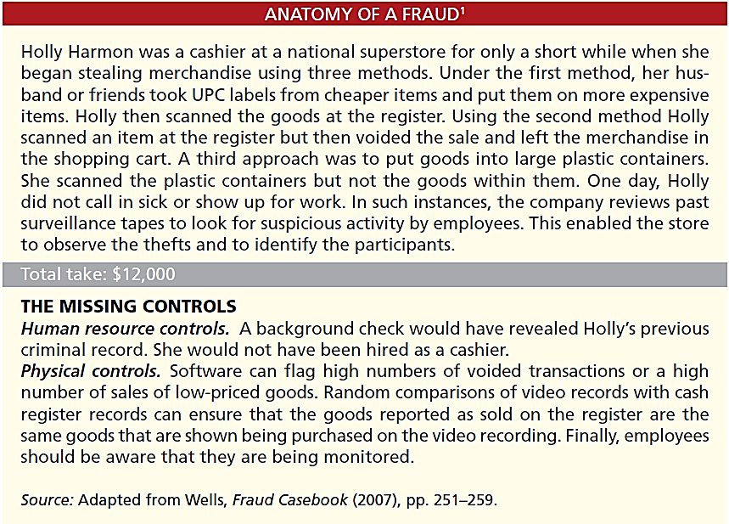
LO 3

Slide 28
Sales Returns and Allowances
“Flip side” of purchase returns and allowances.
Contra-revenue account to Sales Revenue (debit).
Sales not reduced (debited) because:
Would obscure importance of sales returns and allowances as a percentage of sales.
Could distort comparisons.
LO 3

Slide 29
Sales Returns and Allowances
Illustration: Prepare the entry PW Audio Supply would make to record the credit for returned goods that had a $300 selling price (assume a $140 cost). Assume the goods were not defective.
May 8
Sales Returns and Allowances 300
Accounts Receivable 300
8
Inventory 140
Cost of Goods Sold 140
LO 3

Slide 30
Sales Returns and Allowances
Illustration: Assume the returned goods were defective and had a scrap value of $50, PW Audio would make the following entries:
May 8
Sales Returns and Allowances 300
Accounts Receivable 300
8
Inventory 50
Cost of Goods Sold 50
LO 3

Slide 31
Sales Returns and Allowances
Question
The cost of goods sold is determined and recorded each time a sale occurs in:
periodic inventory system only.
a perpetual inventory system only.
both a periodic and perpetual inventory system.
neither a periodic nor perpetual inventory system.
LO 3

Slide 32

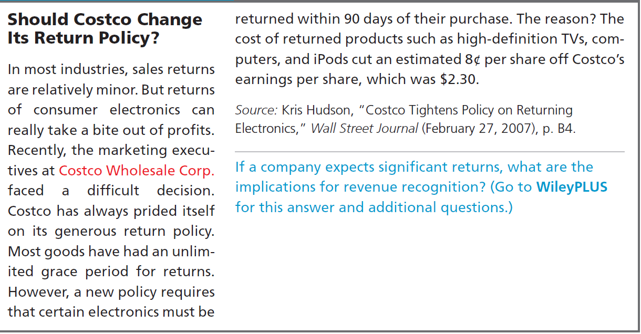
LO 3

Slide 33
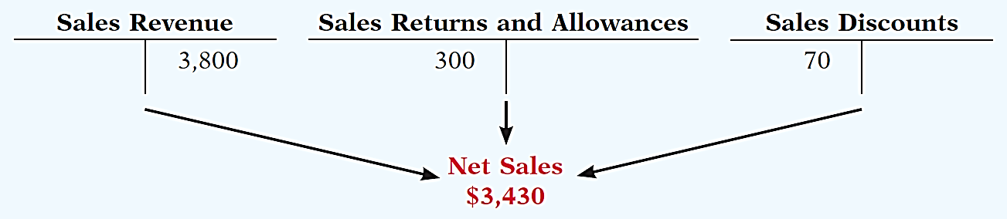
Sales Discount
Offered to customers to promote prompt payment of the balance due.
Contra-revenue account (debit) to Sales Revenue.
LO 3

Slide 34
Sales Discount
Illustration: Assume Sauk Stereo pays the balance due of $3,500 (gross invoice price of $3,800 less purchase returns and allowances of $300) on May 14, the last day of the discount period. Prepare the journal entry PW Audio Supply makes to record the receipt on May 14.
May 14
Cash 3,430
Sales Discounts 70
*
Accounts Receivable 3,500
* [($3,800 – $300) X 2%]
LO 3

Slide 35
DO IT!
3
Sales Transactions
On September 5, De La Hoya Company buys merchandise on account from Junot Diaz Company. The selling price of the goods is $1,500, and the cost to Diaz Company was $800. On September 8, De La Hoya returns defective goods with a selling price of $200 and a fair value of $30. Record the transactions on the books of Junot Diaz Company.
Sept. 5
Accounts Receivable 1,500
Sales Revenue 1,500
Cost of Goods Sold 800
Inventory 800
Sept. 5
LO 3

Slide 36
DO IT!
3
Sales Transactions
On September 5, De La Hoya Company buys merchandise on account from Junot Diaz Company. The selling price of the goods is $1,500, and the cost to Diaz Company was $800. On September 8, De La Hoya returns defective goods with a selling price of $200 and a fair value of $30. Record the transactions on the books of Junot Diaz Company.
Sept. 8
Sales Returns and Allowances 200
Accounts Receivable 200
Inventory 30
Cost of Goods Sold 30
Sept. 8
LO 3

Slide 37
LEARNING
OBJECTIVE
Apply the steps in the accounting cycle to a merchandising company.
4
Adjusting Entries
Generally the same as a service company.
One additional adjustment to make the records agree with the actual inventory on hand.
Involves adjusting Inventory and Cost of Goods Sold.
LO 4

Slide 38
Adjusting Entries
Illustration: Suppose that PW Audio Supply has an unadjusted balance of $40,500 in Merchandise Inventory. Through a physical count, PW Audio determines that its actual merchandise inventory at year-end is $40,000. The company would make an adjusting entry as follows.
Cost of Goods Sold 500
Inventory 500
LO 4

Slide 39
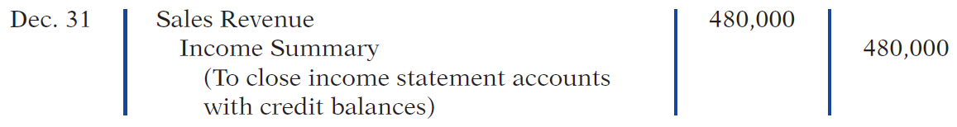
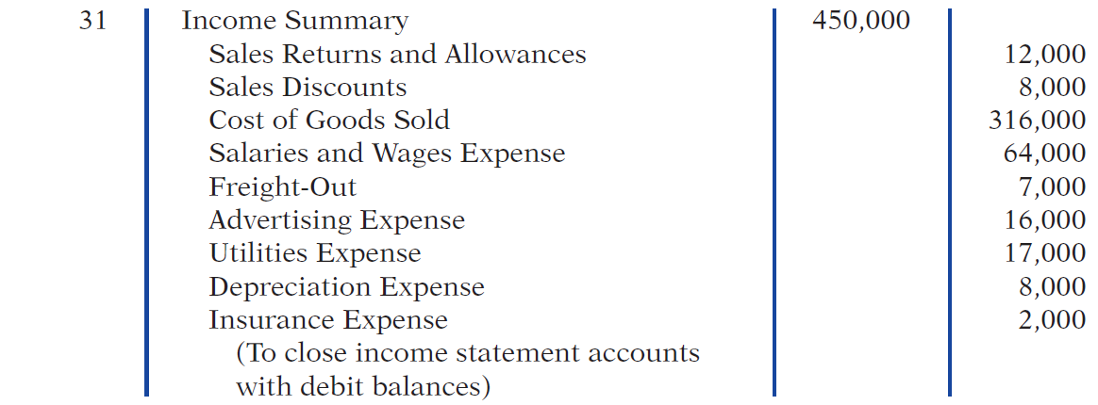
Closing Entries
LO 4

Slide 40
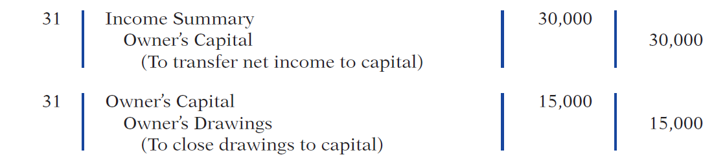
Closing Entries
LO 4

Slide 41
DO IT!
4
Closing Entries
The trial balance of Celine’s Sports Wear Shop at December 31 shows Inventory $25,000, Sales Revenue $162,400, Sales Returns and Allowances $4,800, Sales Discounts $3,600, Cost of Goods Sold $110,000, Rent Revenue $6,000, Freight-Out $1,800, Rent Expense $8,800, and Salaries and Wages Expense $22,000. Prepare the closing entries for the above accounts.
Dec. 31
Sales Revenue 162,400
Rent Revenue 6,000
Income Summary 168,400
LO 4

Slide 42
The trial balance of Celine’s Sports Wear Shop at December 31 shows Inventory $25,000, Sales Revenue $162,400, Sales Returns and Allowances $4,800, Sales Discounts $3,600, Cost of Goods Sold $110,000, Rent Revenue $6,000, Freight-Out $1,800, Rent Expense $8,800, and Salaries and Wages Expense $22,000. Prepare the closing entries for the above accounts.
Dec. 31
Income Summary 151,000
Cost of Goods Sold 110,000
Sales Returns and Allowances 4,800
Sales Discounts 3,600
Freight-Out 1,800
Rent Expense 8,800
Salaries and Wages Expense 22,000
LO 4

Slide 43
LEARNING
OBJECTIVE
Compare a multiple-step with a single-step income statement.
5
Multiple-Step Income Statement
Shows several steps in determining net income.
Two steps relate to principal operating activities.
Distinguishes between operating and non-operating activities.
LO 5

Slide 44
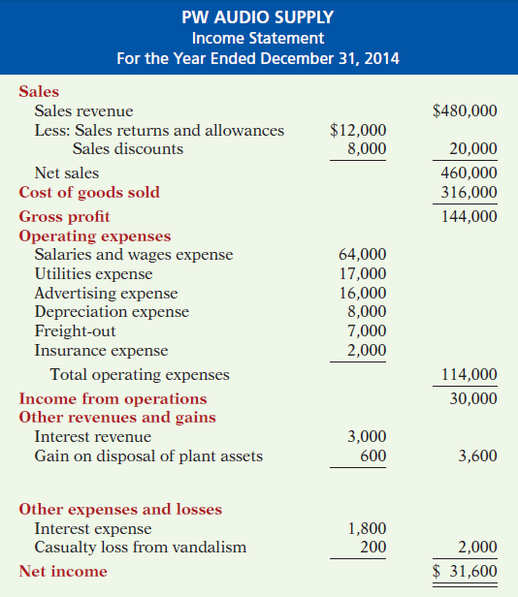


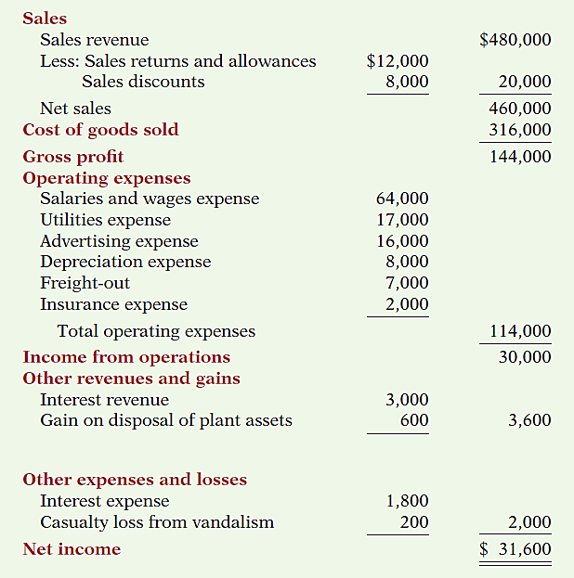
Multiple- Step
Illustration 5-14
Key Items:
Net sales
Illustration 5-14
LO 5

Slide 45
Multiple- Step
Illustration 5-14
Key Items:
Net sales
Gross profit
Illustration 5-14
LO 5

Slide 46
Multiple- Step
Illustration 5-14
Key Items:
Net sales
Gross profit
Operating expenses
Illustration 5-14
LO 5

Slide 47
Multiple- Step
Key Items:
Net sales
Gross profit
Operating expenses
Nonoperating activities
Illustration 5-14
LO 5

Slide 48
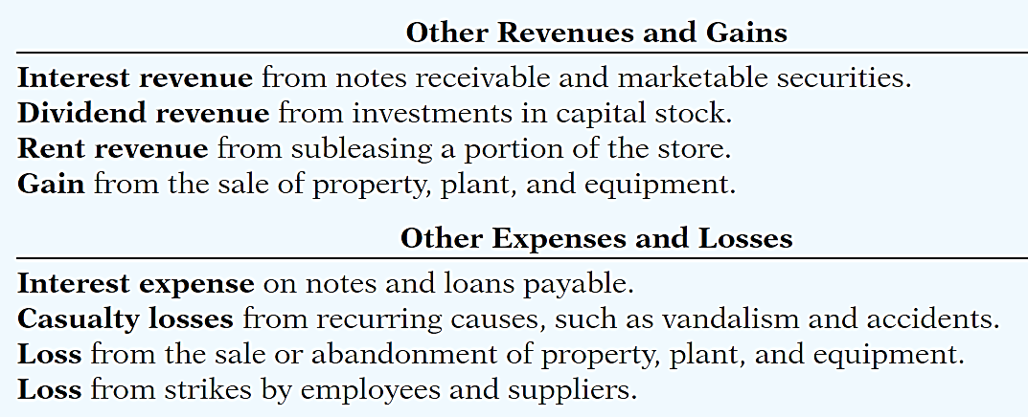
Multiple- Step
Key Items:
Net sales
Gross profit
Operating expenses
Nonoperating activities
Illustration 5-14
LO 5

Slide 49
Multiple- Step
Key Items:
Net sales
Gross profit
Operating expenses
Nonoperating activities
Net income
Illustration 5-14
LO 5

Slide 50
Multiple-Step Income Statement
Question
The multiple-step income statement for a merchandiser shows each of the following features except:
gross profit.
cost of goods sold.
a sales revenue section.
investing activities section.
LO 5

Slide 51

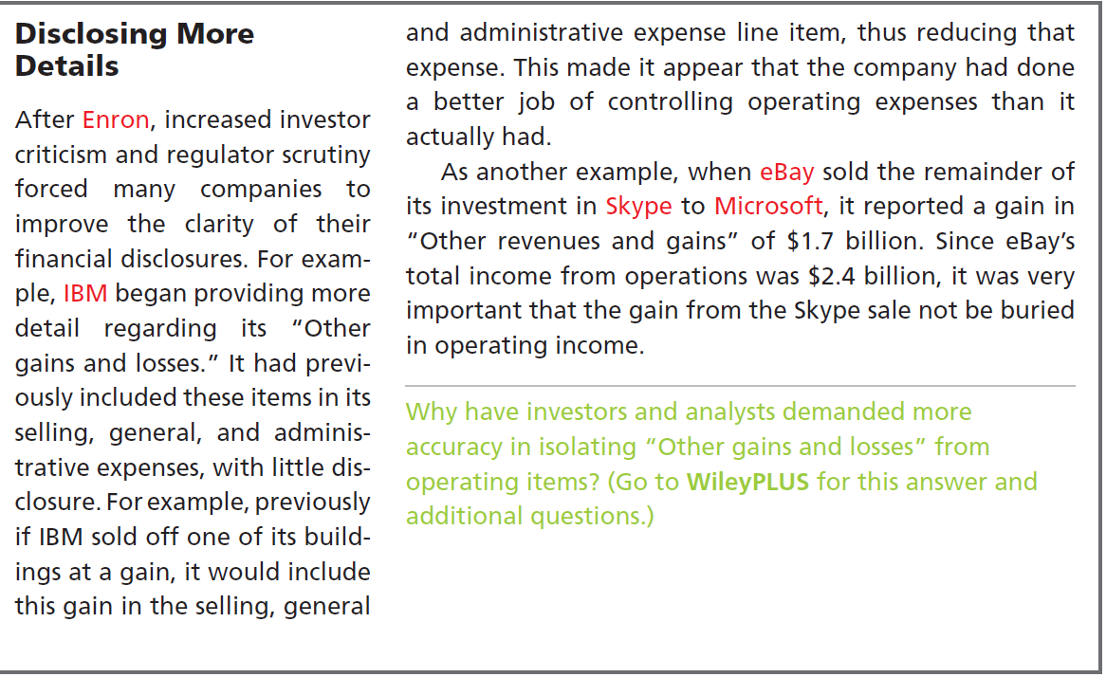
LO 5

Slide 52
Single-Step Income Statement
Subtract total expenses from total revenues
Two reasons for using the single-step format:
Company does not realize any profit until total revenues exceed total expenses.
Format is simpler and easier to read.
LO 5

Slide 53
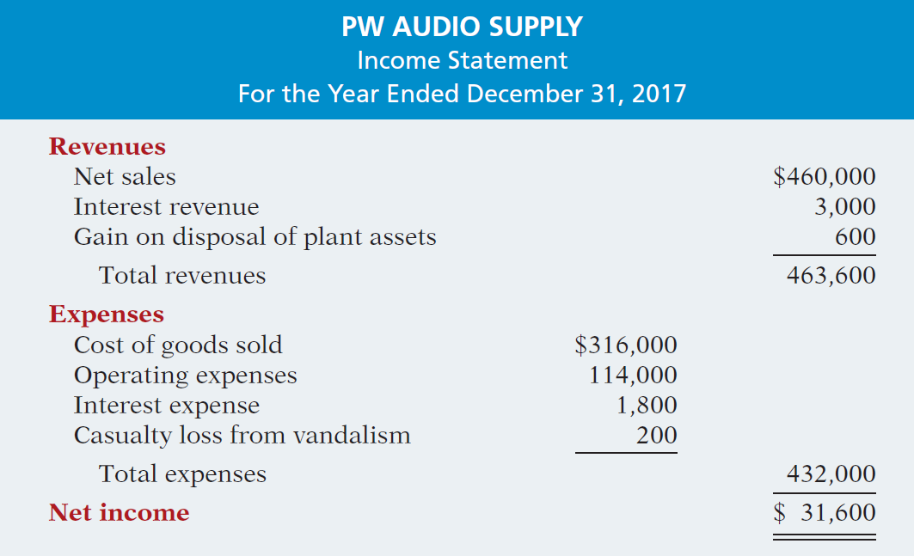
Single-Step Income Statement
Illustration 5-15
LO 5

Slide 54
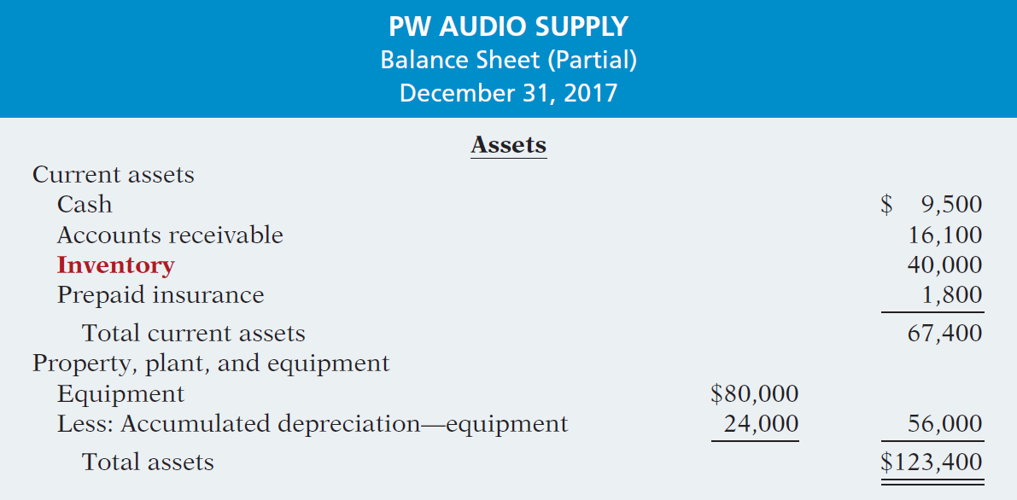
Classified Balance Sheet
Illustration 5-16
LO 5

Slide 55
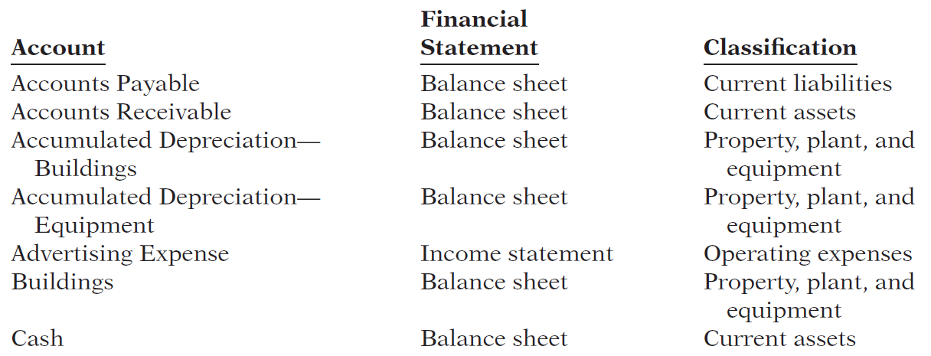
DO IT!
5
Financial Statement Classifications
Indicate in which financial statement and under what classification each of the following accounts would be reported.
LO 5

Slide 56
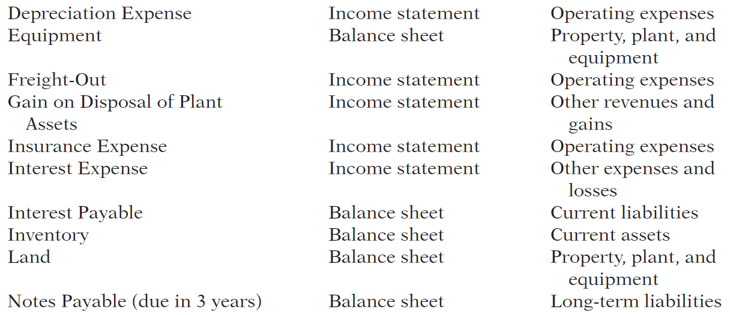
LO 5

Slide 57
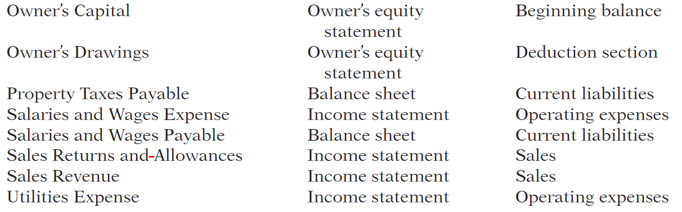
LO 5

Slide 58
LEARNING
OBJECTIVE
APPENDIX 5A: Prepare a worksheet for
a merchandising company.
6
Using a Worksheet
As indicated in Chapter 4, a worksheet enables companies to prepare financial statements before they journalize and post adjusting entries. The steps in preparing a worksheet for a merchandising company are the same as for a service company. Illustration 5A-1 shows the worksheet for PW Audio Supply, Inc. (excluding nonoperating items). The unique accounts for a merchandiser using a perpetual inventory system are in red.
LO 6

Slide 59
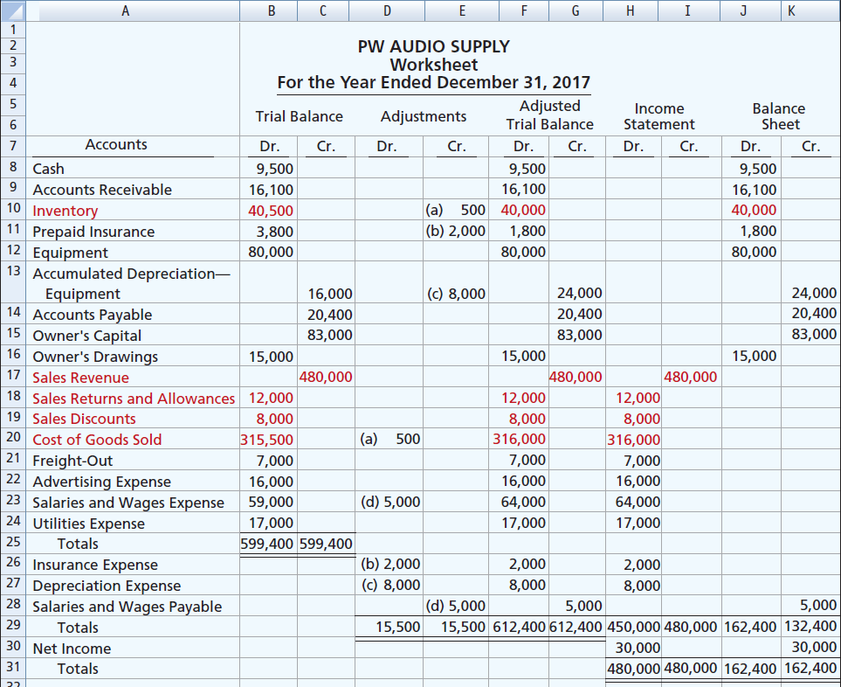
Illustration 5A-1
LO 6

Slide 60
LEARNING
OBJECTIVE
APPENDIX 5B: Record purchases and sales under a periodic inventory system.
7
Determining Cost of Goods Sold Under a Periodic System
No running account of changes in inventory.
Ending inventory determined by physical count.
Cost of goods sold not determined until the end of the period.
LO 7

Slide 61
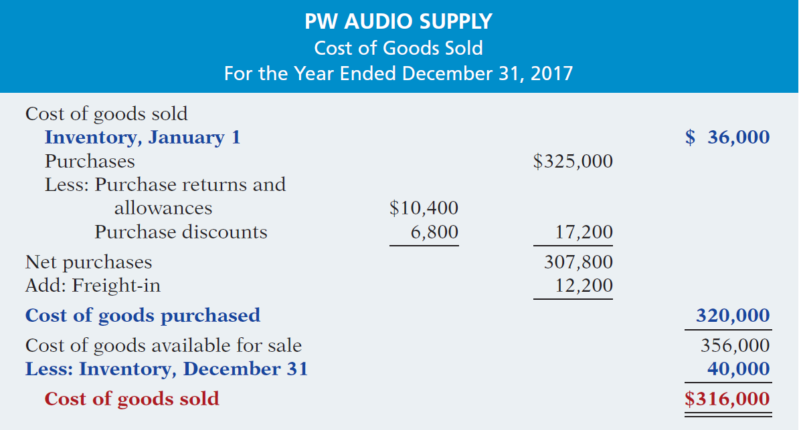
Determining Cost of Goods Sold Under a Periodic System
Illustration 5B-2
Cost of goods sold for a
merchandiser using a periodic
inventory system
Illustration 5B-2
LO 7

Slide 62
Recording Merchandise Transactions
Record revenues when sales are made.
Do not record cost of merchandise sold on the date of sale.
Physical inventory count determines:
Cost of merchandise on hand and
Cost of merchandise sold during the period.
Record purchases in Purchases account.
Purchase returns and allowances, Purchase discounts, and Freight costs are recorded in separate accounts.
LO 7

Slide 63
Recording Purchases of Merchandise
Illustration: On the basis of the sales invoice (Illustration 5-6) and receipt of the merchandise ordered from PW Audio Supply, Sauk Stereo records the $3,800 purchase as follows.
May 4
Purchases 3,800
Accounts Payable 3,800
LO 7

Slide 64
Recording Purchases of Merchandise
FREIGHT COSTS
Illustration: If Sauk pays Public Freight Company $150
for freight charges on its purchase from PW Audio Supply on May 6, the entry on Sauk’s books is:
May 6
Freight-In (Transportation-In) 150
Cash 150
LO 7

Slide 65
Recording Purchases of Merchandise
PURCHASE RETURNS AND ALLOWANCES
Illustration: Sauk Stereo returns $300 of goods to PW Audio Supply and prepares the following entry to recognize the return.
May 8
Accounts payable 300
Purchase Returns and Allowances 300
LO 7

Slide 66
Recording Purchases of Merchandise
PURCHASE DISCOUNTS
Illustration: On May 14 Sauk Stereo pays the balance due on account to PW Audio Supply, taking the 2% cash discount allowed by PW Audio for payment within 10 days. Sauk
Stereo records the payment and discount as follows.
May 14
Accounts Payable 3,500
Purchase Discounts 70
Cash 3,430
LO 7

Slide 67
Recording Sales of Merchandise
Illustration: PW Audio Supply, records the sale of $3,800 of merchandise to Sauk Stereo on May 4 (sales invoice No. 731, Illustration 5-6) as follows.
May 4
Accounts Receivable 3,800
Sales Revenue 3,800
No entry is recorded for cost of goods sold at the time of the sale under a periodic system.
LO 7

Slide 68
Recording Sales of Merchandise
SALES RETURNS AND ALLOWANCES
Illustration: To record the returned goods received from Sauk Stereo on May 8, PW Audio Supply records the $300 sales return as follows.
May 8
Sales Returns and Allowances 300
Accounts Receivable 300
LO 7

Slide 69
Recording Sales of Merchandise
SALES DISCOUNTS
Illustration: On May 14, PW Audio Supply receives payment of $3,430 on account from Sauk Stereo. PW Audio honors the 2% cash discount and records the payment of Sauk’s account receivable in full as follows.
May 14
Cash 3,430
Sales Discounts 70
Accounts Receivable 3,500
LO 7

Slide 70
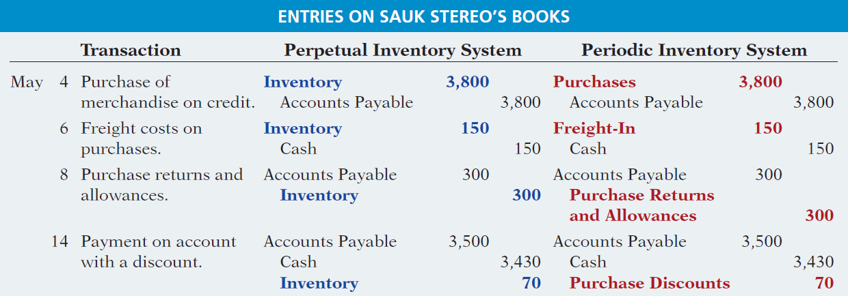
Recording Sales of Merchandise
COMPARISON OF ENTRIES
Illustration 5B-3
LO 7

Slide 71
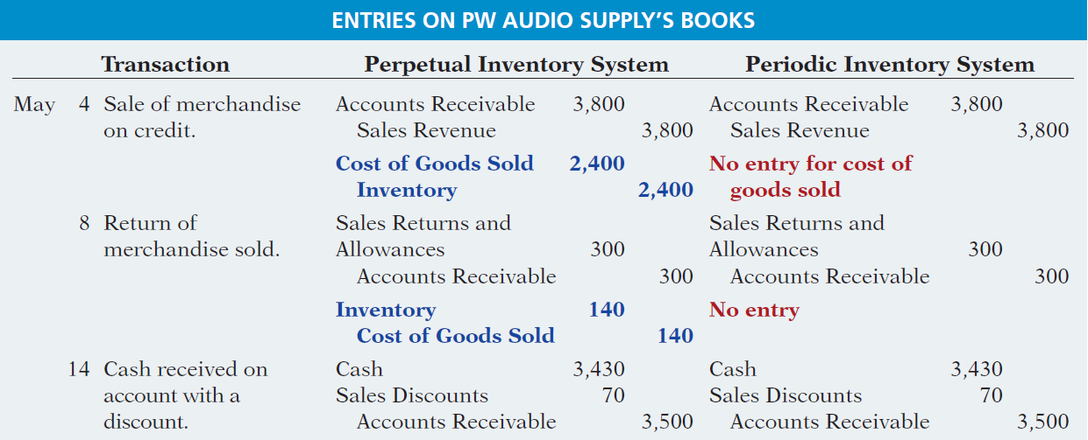
Recording Sales of Merchandise
COMPARISON OF ENTRIES
Illustration 5B-3
LO 7

Slide 72
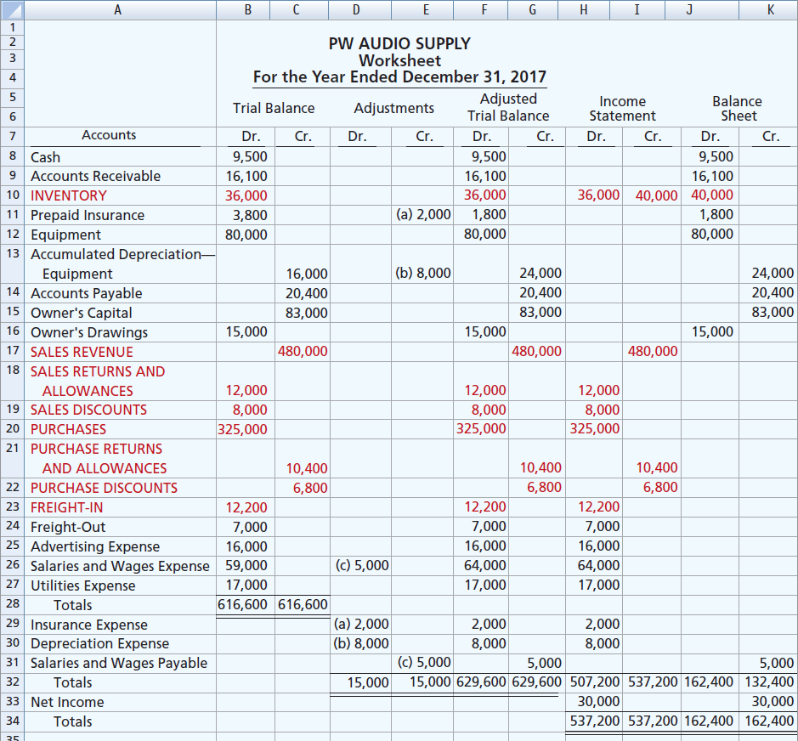
Illustration 5B-5
Worksheet for merchandising
company—periodic inventory system

Slide 73

A Look at IFRS
LEARNING
OBJECTIVE
Compare the accounting for merchandising under GAAP and IFRS.
8
Key Points
Similarities
Under both GAAP and IFRS, a company can choose to use either a perpetual or a periodic inventory system.
The definition of inventories is basically the same under GAAP and IFRS.
As indicated above, the basic accounting entries for merchandising are the same under both GAAP and IFRS.
LO 8

Slide 74
A Look at IFRS
Key Points
Similarities
IFRS requires that 2 years of income statement information be presented, whereas GAAP requires 3 years.
Differences
Under GAAP, companies generally classify income statement items by function. Classification by function leads to descriptions like administration, distribution, and manufacturing. Under IFRS, companies must classify expenses either by nature or by function. Classification by nature leads to descriptions such as the following: salaries, depreciation expense, and utilities expense. If a company uses the functional-expense method on the income statement, disclosure by nature is required in the notes.
LO 8

Slide 75
A Look at IFRS
Key Points
Differences
Presentation of the income statement under GAAP follows either a single-step or multiple-step format. IFRS does not mention a single-step or multiple-step approach.
Under IFRS, revaluation of land, buildings, and intangible assets is permitted. The initial gains and losses resulting from this revaluation are reported as adjustments to equity, often referred to as other comprehensive income . The effect of this difference is that the use of IFRS result in more transactions affecting equity (other comprehensive income) but not net income.
LO 8

Slide 76
A Look at IFRS
Looking to the Future
The IASB and FASB are working on a project that would rework the structure of financial statements. Specifically, this project will address the issue of how to classify various items in the income statement. A main goal of this new approach is to provide information that better represents how businesses are run. In addition, this approach draws attention away from just one number—net income. It will adopt major groupings similar to those currently used by the statement of cash flows (operating, investing, and financing), so that numbers can be more readily traced across statements. For example, the amount of income that is generated by operations would be traceable to the assets and liabilities used to generate the income. Finally, this approach would also provide detail, beyond that currently seen in most statements (either GAAP or IFRS), by requiring that line items be presented both by function and by nature. The new financial statement format was heavily influenced by suggestions from financial statement analysts.
LO 8

Slide 77
A Look at IFRS
IFRS Self-Test Questions
Which of the following would not be included in the definition of inventory under IFRS?
Photocopy paper held for sale by an office-supply store.
Stereo equipment held for sale by an electronics store.
Used office equipment held for sale by the human relations department of a plastics company.
All of the above would meet the definition.
LO 8

Slide 78
A Look at IFRS
IFRS Self-Test Questions
Which of the following would not be a line item of a company reporting costs by nature?
Depreciation expense.
Salaries expense.
Interest expense.
Manufacturing expense.
LO 8

Slide 79
A Look at IFRS
IFRS Self-Test Questions
Which of the following would not be a line item of a company reporting costs by function?
Administration.
Manufacturing.
Utilities expense.
Distribution.
LO 8

Slide 80
Copyright
“Copyright © 2015 John Wiley & Sons, Inc. All rights reserved. Reproduction or translation of this work beyond that permitted in Section 117 of the 1976 United States Copyright Act without the express written permission of the copyright owner is unlawful. Request for further information should be addressed to the Permissions Department, John Wiley & Sons, Inc. The purchaser may make back-up copies for his/her own use only and not for distribution or resale. The Publisher assumes no responsibility for errors, omissions, or damages, caused by the use of these programs or from the use of the information contained herein.”

